Slide 1
21st Century Learning in Physical Education
IAHPERD 2014

Slide 2
For this session...
What is 21st Century Learning
21st Century Skills
Discuss 21st Century Learning in PE
Example Units for Elementary, Middle School, and High School
Recommendations
Skills gathered

Slide 3
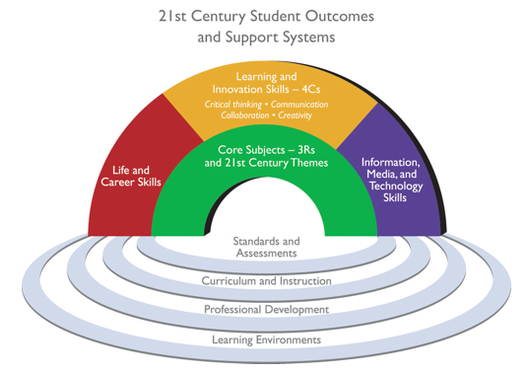
21st Century Learning Skills
Framework for 21st Century

Slide 4
21st Century Learning Skills
How is education changing?
21st Century Skills video

Slide 5
What about P.E.?
What can P.E. teachers leave students with to embrace the change of education?
Is playing games, receiving general health knowledge, and being active enough?

Slide 6
21st Century Learning is...
Student centered and personalized
Offering experiences and opportunities to apply knowledge
Accessible 24 hours/day, 7 days/week, 52 weeks/year
ANYTIME, ANYWHERE

Slide 7
My suggestion
Provide Inquiry Based Learning unit for content taught in P.E.

Slide 8
What is Inquiry Based Learning?
Posing questions, problems or scenarios—rather than simply presenting established facts or portraying a smooth path to knowledge.

Slide 9
Technology used in P.E.
What technology can be used in P.E.?

Slide 10
How to use technology efficiently in P.E.
Recommendations
Students should be familiar with device
Teachers must be familiar with device/apps
Plan for lots of prep time for unit
Rely on classroom teachers for student training
Only plan for small tasks each day

Slide 11
Technology used
Chromebooks for ¼ of class
LCD Projector (with HDMI capabilities)
Chromecast

Slide 12
Heart Health Education Ex.
Follow Principles for designing IBL unit
Design of Unit
Provide backgroud knowledge
Ask questions
Gather information
Construct knowledge
Make knowledge visible
Presentation & Feedback

Slide 13
Inquiry Based Learning
Background knowledge
Watch a video
Read an article
Large group discussion

Slide 14
Inquiry Based Learning
Ask questions
Pose essential question:
Why is heart health important?
Encourage students to ask further questions about the heart/heart health.

Slide 15
Inquiry Based Learning
Gather Information
*Elementary - gather web resources for students to easily and safely find the correct information
Students use web to research answers to questions
Email experts, survey peers/community members

Slide 16
Inquiry Based Learning
Middle School/High School
Students can have more web responsibility
Ex. of questions students can research
How does the amount of $ spent on Heart Health affect taxpayers or insurance carriers? How does it affect you directly?
How will you commit to healthy heart lifestyle?
How would you motivate a community of people who are not interested in physical activity?
Assessment ex. : How might your physical activity change based on what you know about heart health? (essay)

Slide 17
Inquiry Based Learning
Construct knowledge
Students synthesize findings
Draw conclusions about research
Apply knowledge
Create concept map
Drawings
Graphs
Blog
Essays

Slide 18
Inquiry Based Learning
Make knowledge visible
Use technology to create a presentation
PowerPoint
Google Presentation
PowToons
Prezi
iMovie
Movie Maker

Slide 19
Inquiry Based Learning
Presentation & Feedback
Short presentations in groups/partners/individuals
Assign groups/partners/individuals to evaluate peers

Slide 20
21st Century skills addressed
Collaboration
Creativity
Data Collection
Communication
Research
Evaluation
Critical thinking
Information literacy
Technology literacy
Health literacy

Slide 21
Heart Health Elementary School
Project Suggestions:
Assign research ?’s in part to students
Elementary students (3-5) research smaller parts of a larger project

Slide 22
Suggested Units
Content Units - Nutrition, Fitness, Heart Health, Health Related Fitness Components
Sports Units - introduction, kinesiology, sports science
Any unit that requires research or learning

Slide 23
Technology needed
No one right answer
Devices for 1:1
Devices for small groups
LCD Projector
Connection wire/Chromecast

Slide 24
Email
sbell@d428.org
IAHPERD presentation

